Slide 1
Diyala University
College of Engineering
Department of Computer Engineering
Application CPLD
in sequential Circuit

Slide 2
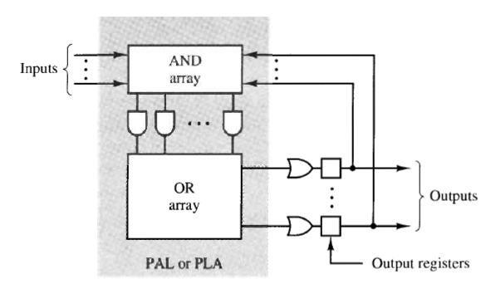
General structure of register PLD

Slide 3
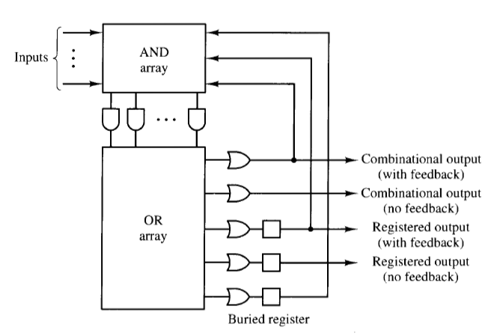
Registered PLD output options

Slide 4
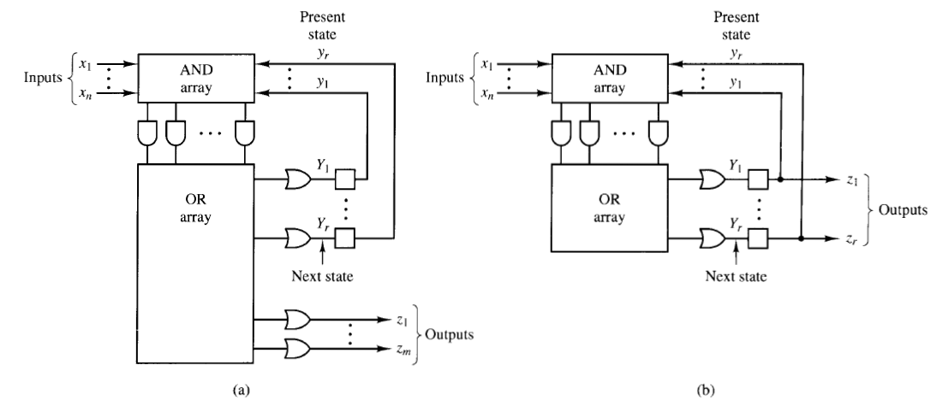
Sequential circuit models mapped onto registered PLDs
(a) Mealy mode (b) Moore model(zi=yi)

Slide 5
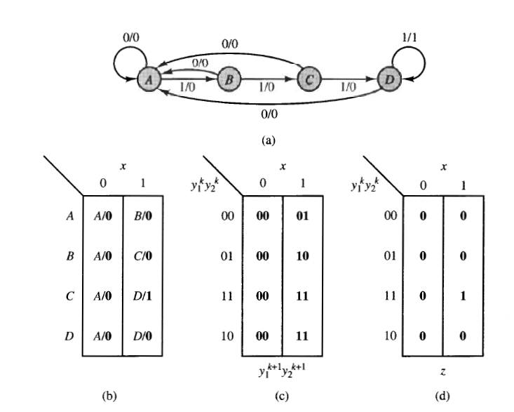
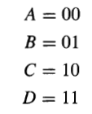
Example :
Design circuit with one input x and one output z that will produce an output of 1
whenever the last four inputs are 1 , that is , a circuit that recognize the input
sequence x=1111. realize the circuit in PAL16R6 device.

Slide 6
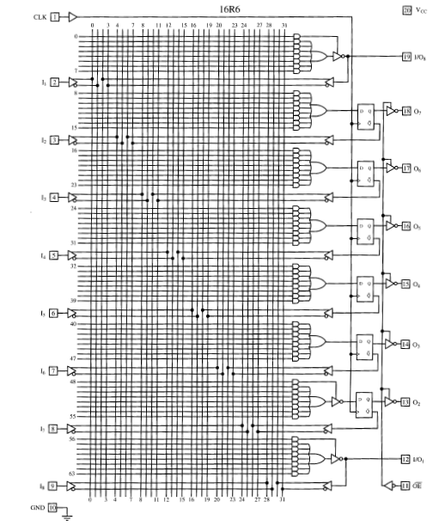
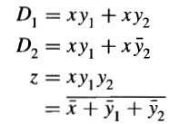

Slide 7
